Slide 1

Enhancing Machine Learning Forecasting with Data Visualization
Sailaxmi Kameta
Advisor - Mihaela Sabin
Masters in Information Technology
05/08/2025

Slide 2
Introduction
Integration of machine learning with full-stack web development.
Use of ARIMA model for forecasting
Develop web application using Django framework
SQLite Database for data management
Notes:
Goal: To develop a forecasting system that integrates the ARIMA machine learning model for sales prediction with a full-stack web application built using Django for storing and visualizing forecasting results.
This project explores the development of a forecasting system that integrates machine learning with full-stack web development to analyze and visualize sales trends. Specifically, it focuses on implementing the Autoregressive Integrated Moving Average (ARIMA) model to perform time series forecasting on historical sales data. The system is designed as a web application using the Django framework, with SQLite Studio for backend database management and Django Template Language (DTL) for rendering forecasting results on the front end. The web application prototype will provide an intuitive interface where users input data, trigger forecasts, and visualize predictions.

Slide 3
Objectives
Understand and apply the ARIMA forecasting model.
1
Develop a backend using Django and SQLite Studio.
2
Implement frontend using Django Template Language (DTL), HTML, CSS and Plotly
3
Notes:
First, the core of this project revolves around sales forecasting and predictive analysis. I implemented the ARIMA model, a statistical method, to analyze historical sales data and forecast future trends, this method is well-suited for time-series data. So what is time-series: A series of data points collected over time at regular intervals like every hour, day, week and so on. I used SQLite as the database because it’s lightweight, easy to set up, and perfectly suited for a local development environment. Its integration in the Django framework eliminates the need for installing a separate database server.
I chose Django as my backend framework. My interest in Django grew while studying COMP 805, where I explored how Django manages web development. Django’s Model-View-Template architecture allowed me to organize the backend, frontend, and database in one framework. It simplified development and helped maintain a modular structure. I used HTML, Django Template Language (DTL), and Tailwind CSS. HTML laid the structure of the web pages, while DTL enabled dynamic content rendering between the backend and frontend. Tailwind CSS helped me quickly style the interface with consistent design. I integrated Plotly, a visualization library. It allowed me to create interactive charts where users can hover, zoom, and inspect data trends. Altogether, these technologies worked together to meet the goal of building a full-stack web application.

Slide 4

Approach – Why ARIMA for forecasting
ARIMA (AutoRegressive Integrated Moving Average) is a statistical model for forecasting time series data.
Core Components:
AR (AutoRegressive): Uses past values.
I (Integrated): Makes data stationary.
MA (Moving Average): Uses past forecast errors.
Why it's ideal:
Works efficiently with univariate data (e.g., sales).
Less data and computation needed vs ML models like LSTM or XGBoost.
Notes:
AutoRegressive (AR) component uses the past values for forecasting the next value. Integrated (I) component involves differencing where it calculates the number of times the differencing operation is performed on series to make the time series stationary i.e., the statistical properties like mean and variance remain constant over time. Moving Average (MA) component uses past errors where error = actual-predicted value
In my project, I used sales data, which is univariate, meaning there’s only one main variable evolving over time — the sales values.

Slide 5
Why Auto ARIMA?
What is Auto ARIMA?
Automates parameter tuning (p, d, q).
Uses AIC/BIC (Akaike Information Criterion) to choose the best model.
Why it's useful:
Saves time and manual tuning.
Prevents overfitting/underfitting.
My Use Case:
Applied Auto ARIMA to Rossmann store sales data for best-fit forecasting.
Notes:
Choosing the correct ARIMA parameters manually can be time-consuming and error-prone. Auto-ARIMA helps by testing multiple combinations of parameters and selecting the best one using AIC(Akaike Information Criterion) and BIC scores the lower, the better. This automation speeds up the process and improves model performance. It also determines whether the data needs differencing (the ‘I’ in ARIMA), helping ensure the series is stationary before modeling. I used the Rossmann dataset, which contains daily sales records from multiple retail stores, along with metadata like promotions and holidays. I used Pandas to clean the data, forward-fill missing values, and transform features for modeling. For each store, I applied Auto-ARIMA with exogenous variables like promotions and holidays. The forecasts were then visualized using Plotly and integrated into a Django web app. This allowed users to view forecasts, download CSVs, and even manage sales and inventory data. Other models like LSTM, and XGBoost were considered. Long Short Term Memory (LSTM), a deep learning model, requires more data, GPU resources, and a deeper understanding of neural networks. XGBoost is powerful but not designed for time series it needs careful feature engineering. In contrast, ARIMA is simpler, easier to explain, and more aligned with our dataset's characteristics, making it the most practical and effective choice for this project.

Slide 6
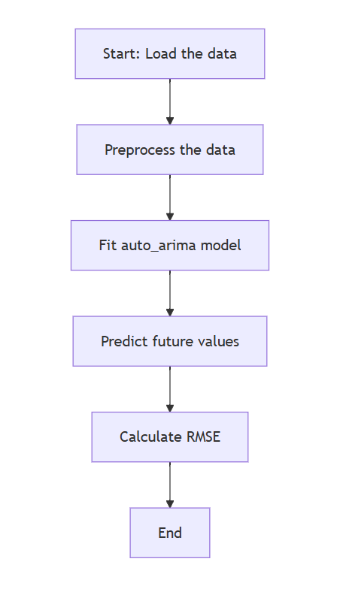
Implementation Steps
Data Preparation:
· Merged train & store data.
· Cleaned, handled missing values
Modeling:
· Log transformation of sales.
· Split data (80/20).
· Used pmdarima.auto_arima().
Forecasting :
· Predicted 30-day sales.
Notes:
Data Preparation
First, I merged the train and store datasets to create a single, unified dataset for modeling.
Then I cleaned the data by checking for and handling missing values to ensure accuracy.
Modeling
I applied a log transformation to the sales column to stabilize the variance and make the data more suitable for ARIMA modeling.
After that, I split the data into training and testing sets, using an 80/20 ratio.
To select the best ARIMA model parameters (p, d, q), I used pmdarima.auto_arima(), which performs automated model selection based on AIC/BIC.
Forecasting
Once the modelling is done, I used it to predict sales for the next 30 days.
This gave us insight into future sales trends and helped validate the model's forecasting ability.

Slide 7

Results
Achieved accurate sales forecasting using Auto-ARIMA
Successfully visualized trends in sales across stores
Interactive charts enabled user-friendly insights

Slide 8
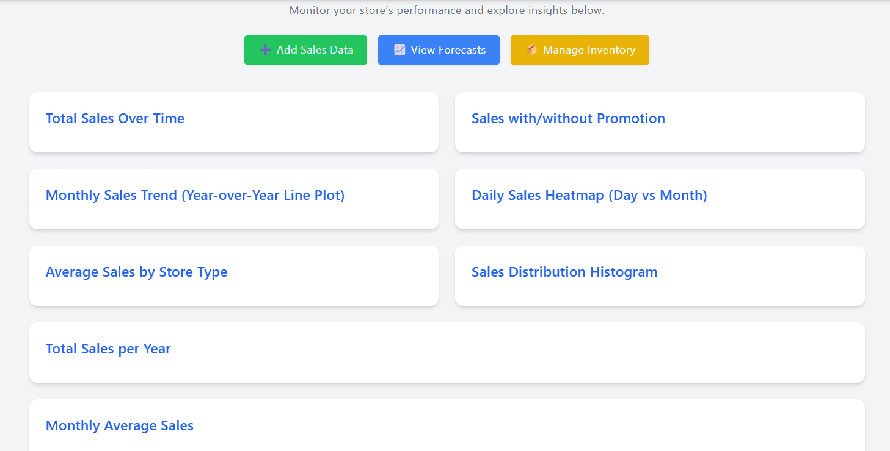
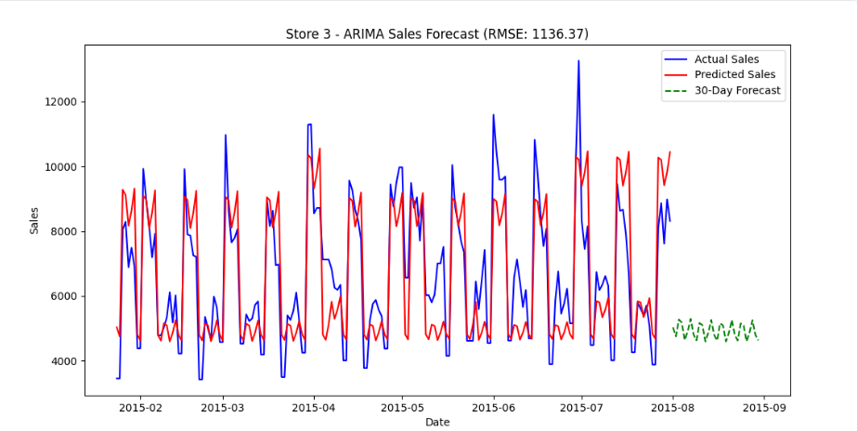
Results

Slide 9
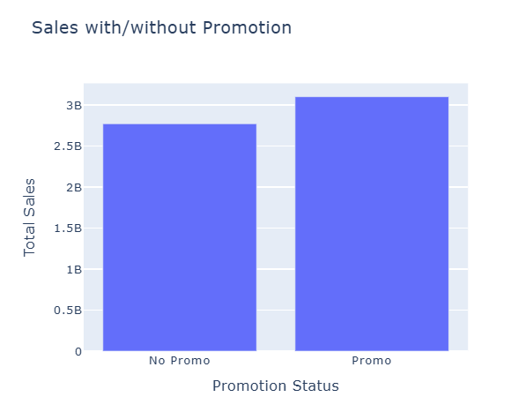
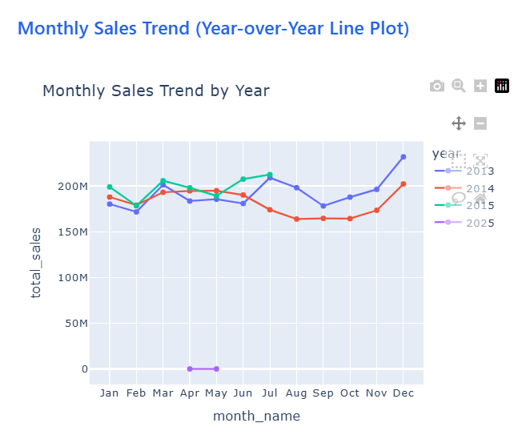
Results
Notes:
I queried the Sales model to group data by the promo field, which indicates whether a promotion was applied (0 = No Promo, 1 = Promo).
Using Django ORM, I calculated the total sales for each promotion group using .annotate(total_sales=Sum('sales')).
I converted the queryset to a pandas DataFrame so it could be used with Plotly Express.
Then I created a bar chart using px.bar() to visualize total sales for each promotion category.
to extract the year and month from the date field in the Sales model using ExtractYear and ExtractMonth. Then I grouped the data by both year and month and calculated total sales for each group

Slide 10
Evaluation
All key objectives successfully achieved.
Challenges:
Slow forecasting when looping through all stores
Auto ARIMA failed to predict future 30 days initially
Solutions:
Optimized ARIMA to take store ID as input
Added checkpointing to skip already-forecasted stores
Notes:
In this project, I encountered several technical and performance-related challenges. One of the main challenges was the time it took to generate forecasts when running the ARIMA model across all stores in a loop. This made the system slow. Another challenge was with Auto ARIMA initially, it could only generate predictions for past data, not for future sales, which was a critical part of the project. To overcome these, I restructured the forecasting process to take a specific store ID as input, allowing forecasts to be generated individually instead of in bulk. This significantly improved performance. I also introduced a checkpoint mechanism to skip already-processed stores, avoiding unnecessary re-runs. For the future prediction issue, I fixed the logic by identifying the last date in the dataset and programmatically extending it by 30 days, which allowed the model to forecast into the future. There were some limitations. The model’s accuracy varied depending on the sales volume of each store stores with more fluctuating sales were harder to predict. Also, due to time constraints and limited data, I couldn't implement additional features like holiday effects or regional trends. From this experience, I learned that integrating machine learning into web applications requires careful planning. Modular design, efficient data handling, and performance optimization are essential, especially when working with time-series data at scale.

Slide 11
References
[1] NetSuite.com. (n.d.). Demand forecasting: Everything you need to know. Oracle NetSuite. https://www.netsuite.com/portal/resource/articles/inventory-management/demand-forecasting.shtml
[2] Brownlee, J. (2023, November 18). How to create an Arima model for time series forecasting in Python. MachineLearningMastery.com. https://machinelearningmastery.com/arima-for-time-series-forecasting-with-python/
[3] Python data analysis with Pandas and Matplotlib. (n.d.). https://ourcodingclub.github.io/tutorials/pandas-python-intro/
[4] Wikimedia Foundation. (2025, April 20). Autoregressive integrated moving average. Wikipedia. https://en.wikipedia.org/wiki/Autoregressive_integrated_moving_average
[5] Hayes, A. (n.d.). Autoregressive integrated moving average (ARIMA) prediction model. Investopedia. https://www.investopedia.com/terms/a/autoregressive-integrated-moving-average-arima.asp
[6] Introduction to pandas. Programiz. (n.d.). https://www.programiz.com/python-programming/pandas/introduction
[7] Arima for time series forecasting explained. Restackio. (n.d.). https://www.restack.io/p/ai-powered-forecasting-answer-arima-time-series-cat-ai
[8] GeeksforGeeks. (2020b, February 19). Python: Arima model for time series forecasting. https://www.geeksforgeeks.org/python-arima-model-for-time-series-forecasting/
[9] Bhatt, D. (2023, November 3). Time series analysis and forecasting with Arima in python. Medium. https://medium.com/datainc/time-series-analysis-and-forecasting-with-arima-in-python-aa22694b3aaa
[10] Singh, A. (2025, May 2). Build high performance time series models using Auto Arima in python and R. Analytics Vidhya. https://www.analyticsvidhya.com/blog/2018/08/auto-arima-time-series-modeling-python-r/
[11] Plotly. Plotly Python Graphing Library. (n.d.). https://plotly.com/python/
[12] Gueco, M. A. (n.d.). Mean squared error (MSE) and root mean squared error (RMSE). Microsoft Q&A. https://learn.microsoft.com/en-us/answers/questions/1633642/mean-squared-error-(mse)-and-root-mean-squared-err
[13] DSkapinakis. (n.d.). DSkapinakis/sales-time-series-forecasting-ML-models: Sales time series forecasting using machine learning techniques (Random Forest, XGBoost, stacked ensemble regressor). GitHub. https://github.com/DSkapinakis/sales-time-series-forecasting-ml-models/tree/main
[14] Mistry, P. (2021a, June 22). Rossmann store sales. Kaggle. https://www.kaggle.com/datasets/priyankamistry/rossmann-store-sales

Slide 12

Q&A

Slide 13

Thank You!

